Slide 1


Author: Ng Chung Pak
Date: 09th Jan 2025

Slide 2

Outline
Executive Summary
Introduction
Methodology
Results
Conclusion
Appendix

Slide 3
Executive Summary: Methodology
Data Collection Integration:
Integrated data from SpaceX API and Wikipedia
Created comprehensive launch database
Developed automated data collection pipeline
Data Analysis Process
Cleaned and preprocessed launch data
Conducted exploratory data analysis
Built interactive visualization dashboards
Developed predictive machine learning models

Slide 4
Executive Summary: Key Findings
Launch Success Factors
Site location impacts success by up to 17%
Optimal payload: 2000-5000 kg
85% success rate since 2013
Model Results
Landing prediction accuracy: 84%
Identified top 3 success indicators
Cost estimation framework validated

Slide 5
Executive Summary: Business Impact
Strategic Value
Competitive pricing enabled
Launch costs optimized
Data-driven decisions supported
Next Steps
Real-time prediction system
Enhanced cost modeling
Expanded feature analysis

Slide 6
Introduction: Background
Commercial Space Race
Space travel becoming more affordable
Multiple companies entering market
SpaceX leads in cost efficiency
SpaceX Advantage
Falcon 9 launches: $62M vs. $165M industry standard
Key differentiator: Reusable first stage
80%+ of launch costs in first stage

Slide 7
Introduction: Project Context
Business Challenge
New company Space Y aims to compete with SpaceX
Need to understand launch cost driver
First stage recovery critical for profitability
Project Goals
Predict first stage landing success
Analyze key success factors
Build cost estimation framework

Slide 8

Section 1

Slide 9
Methodology
Executive Summary
Data collection methodology:
Describe how data was collected
Perform data wrangling
Describe how data was processed
Perform exploratory data analysis (EDA) using visualization and SQL
Perform interactive visual analytics using Folium and Plotly Dash
Perform predictive analysis using classification models
How to build, tune, evaluate classification models

Slide 10

Data Collection – SpaceX API
Flowchart of SpaceX API calls
GitHub URL of the SpaceX API calls notebook:
https://github.com/kennethPakChungNg/spacex-launch-prediction/blob/main/notebooks/jupyter-labs-spacex-data-collection-api.ipynb

Slide 11

Data Collection - Scraping
Flowchart of Web Scraping Collection
GitHub URL of the SpaceX web scraping notebook:
https://github.com/kennethPakChungNg/spacex-launch-prediction/blob/main/notebooks/jupyter-labs-webscraping.ipynb

Slide 12
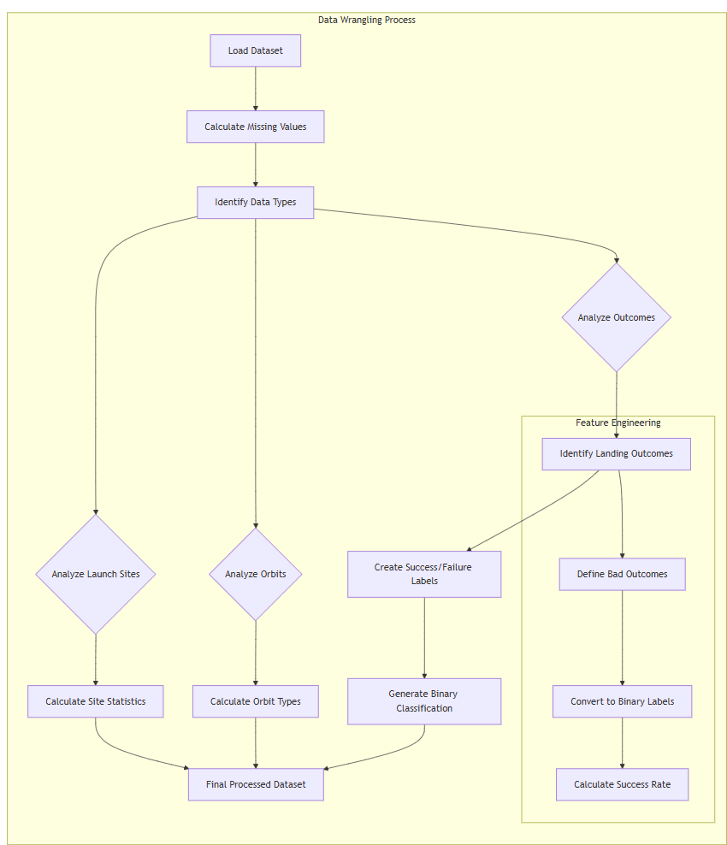
Data Wrangling
Flowchart of Data Wrangling
Filtering Falcon 9 launches
Handling missing values
Feature engineering
GitHub URL of the SpaceX Data Wrangling notebook:
https://github.com/kennethPakChungNg/spacex-launch-prediction/blob/main/notebooks/labs-jupyter-spacex-Data%20wrangling.ipynb

Slide 13
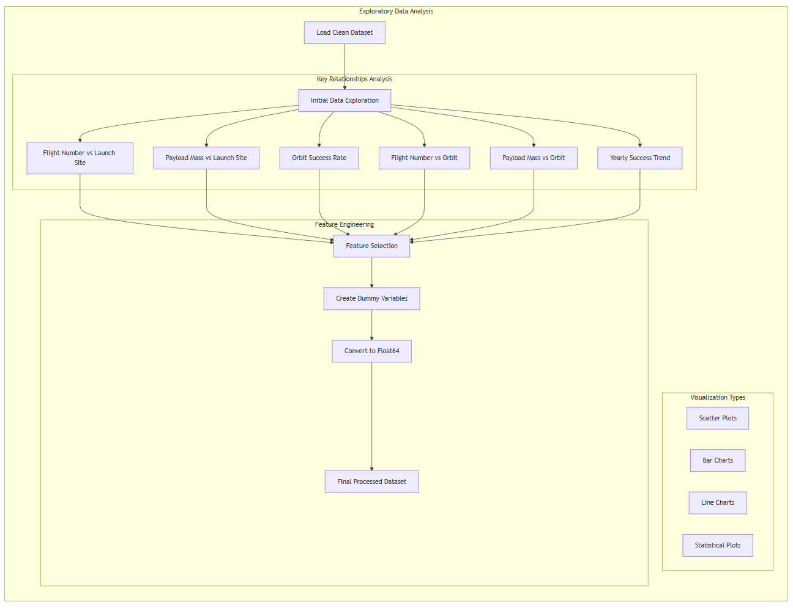
EDA with Data Visualization
Flight Number vs Payload Mass - Shows launch success trends over time with payload impact
Launch Site Analysis - Reveals site-specific success patterns
Orbit Type Success Rates - Bar chart showing success rates by orbit type
Flight Number/Orbit Relationships - Scatter plots revealing correlations
Payload Mass/Orbit Analysis - Impact of payload on different orbits
Yearly Success Trend - Line chart showing improvement over time
Flowchart of Data Visualization
GitHub URL of the SpaceX Data Visualization notebook:
https://github.com/kennethPakChungNg/spacex-launch-prediction/blob/main/notebooks/edadataviz.ipynb

Slide 14
EDA with SQL
Key SQL Queries Performed:
Launch Site Analysis
Identified unique launch sites
Filtered sites starting with 'CCA'
Payload Analysis
Total NASA payload mass
Average mass for F9 v1.1 boosters
Maximum payload carriers
Landing Outcomes
First successful ground pad landing
Success/failure mission counts
Drone ship landing success with payload constraints
Temporal Analysis
Monthly analysis for 2015
Landing outcome rankings 2010-2017
Success trends over time
GitHub URL of the SpaceX EDA with SQL notebook:
https://github.com/kennethPakChungNg/spacex-launch-prediction/blob/main/notebooks/jupyter-labs-eda-sql-coursera_sqllite.ipynb

Slide 15
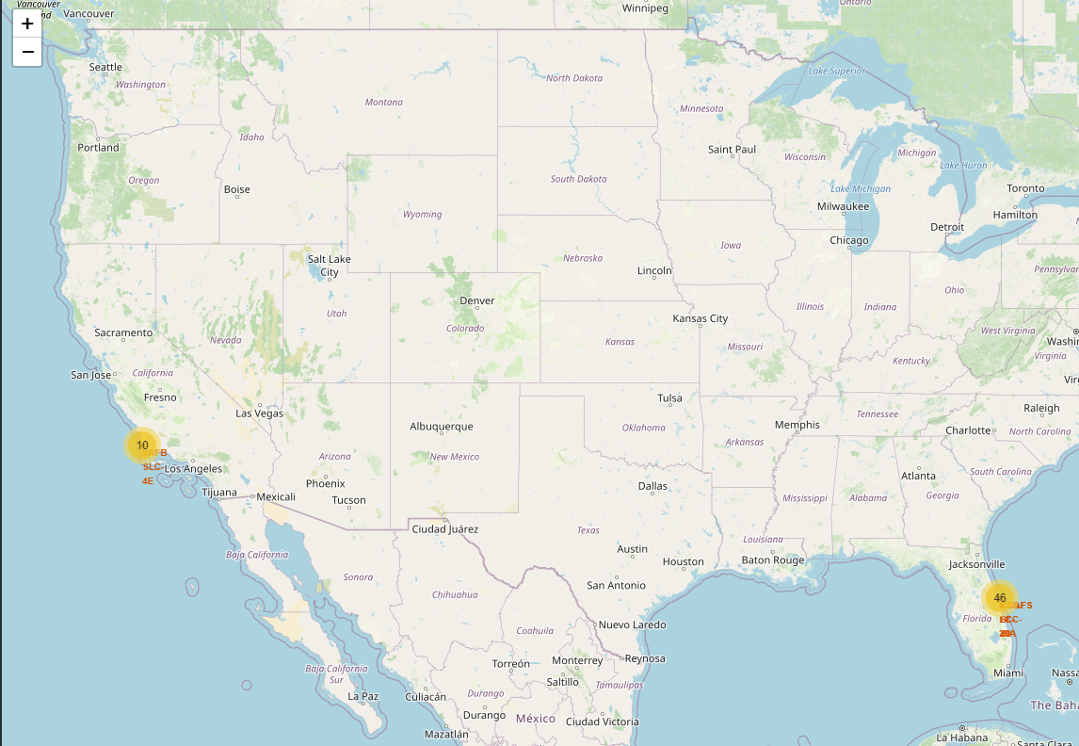
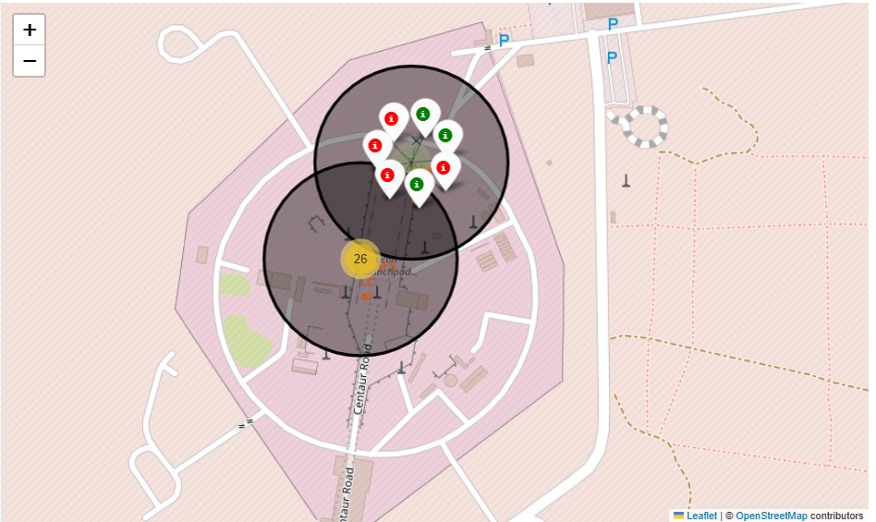
Build an Interactive Map with Folium
Launch Site Locations Overview
Key Features:
Launch sites marked with circle markers
Color-coded launch outcomes (green=success, red=failure)
Marker clusters showing launch frequency
Interactive zoom capabilities
Findings:
Strategic coastal positioning
Concentrated in Florida and California
Clear success rate patterns by location
Map 1: Overview Map
Map 2: Detailed View

Slide 16
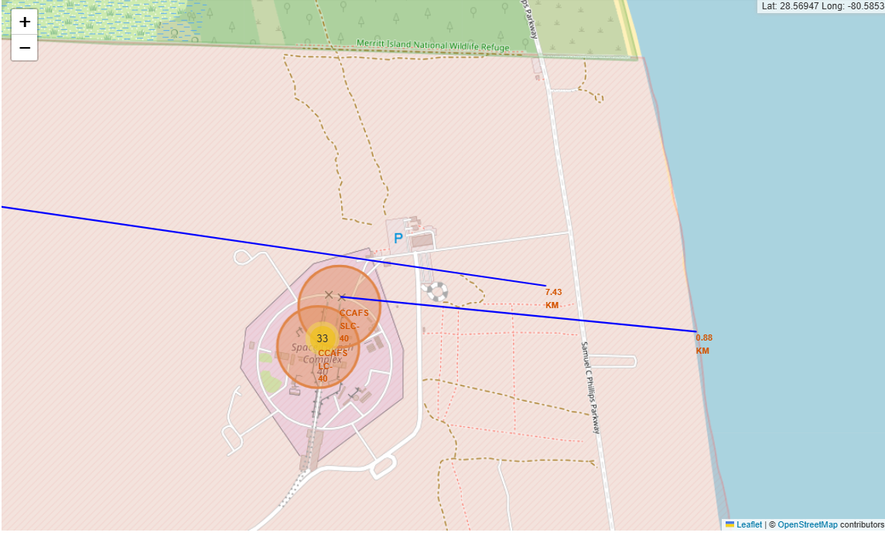
Build an Interactive Map with Folium
Infrastructure Access:
Coastline: 5-8 km
Railways: ~10 km
Highways: ~12 km
Urban areas: Safe distance maintained
Impact on Success:
Coastal proximity enables safe booster returns
Transportation infrastructure supports operations
Urban distance ensures safety compliance

Slide 17
Build a Dashboard with Plotly Dash
Summary of Plots and Interactions in the SpaceX Launch Prediction Dashboard
Launch Site Dropdown:
Purpose: Allows users to select a specific launch site or view all sites.
Why Added: Provides flexibility in analyzing success rates across different launch sites.
Pie Chart:
Purpose: Displays the proportion of successful launches by site or success vs. failure for a selected site.
Why Added: Effectively shows the distribution of successful and failed launches, highlighting proportions at a glance.
Payload Slider:
Purpose: Enables users to filter data based on payload mass range.
Why Added: Payload mass significantly impacts launch success, allowing users to explore this relationship dynamically.
Scatter Plot:
Purpose: Illustrates the correlation between payload mass and launch success, colored by booster version category.
Why Added: Provides a deeper analysis of how payload mass and booster versions influence launch outcomes.
Explanation of Choices:
Interactivity: The dropdown and slider empower users to explore data from various perspectives, enhancing engagement and insights.
Data Visualization:
The pie chart offers an overview of success rates, making it easy to compare sites.
The scatter plot allows for detailed analysis of the relationship between payload mass and success, with additional insights from booster version categories.
Github: https://github.com/kennethPakChungNg/spacex-launch-prediction/blob/main/spacex_dash_app.py

Slide 18
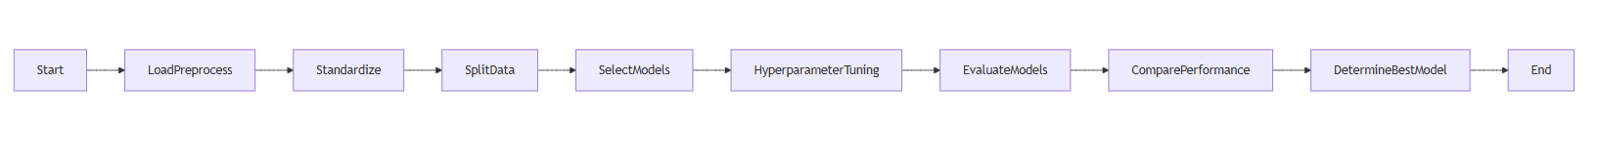
Predictive Analysis (Classification)
Model Development Process
Data Loading and Preprocessing: Loaded and preprocessed the dataset to ensure it is ready for modeling.
Feature Standardization: Standardized the features to normalize the data distribution.
Data Splitting: Split the data into training and test sets to evaluate model performance.
Model Selection: Selected four models: Logistic Regression, Support Vector Machine (SVM), Decision Tree, and K-Nearest Neighbors (KNN).
Hyperparameter Tuning: Tuned hyperparameters using GridSearchCV to optimize model performance.
Model Evaluation: Evaluated the models on the test data to assess their accuracy.
Performance Comparison: Compared the performances of the models to identify the best one.
Best Model Selection: Selected the Decision Tree model as the best performing model based on accuracy.
Based on the evaluations, I determined that the Decision Tree model performed the best with the highest cross-validation and test accuracy. This structured approach ensured that I selected the most effective model for the task.

Slide 19
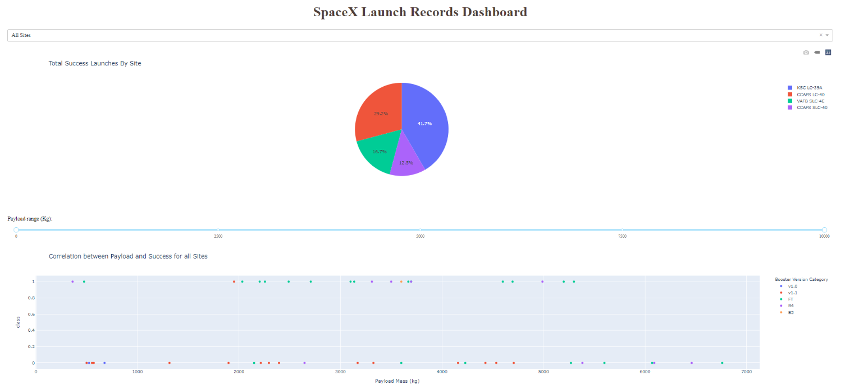
Results
Predictive Analysis Results:
Compared models: Logistic Regression, SVM, Decision Tree, KNN.
Decision Tree performed best with highest cross-validation accuracy.
All models showed similar test accuracy around 83%.
Exploratory Data Analysis (EDA) Results
Success rates vary significantly by orbit type.
Notable improvement in success rates over the years.
Medium payload mass category shows higher success rates.

Slide 20

Section 2

Slide 21
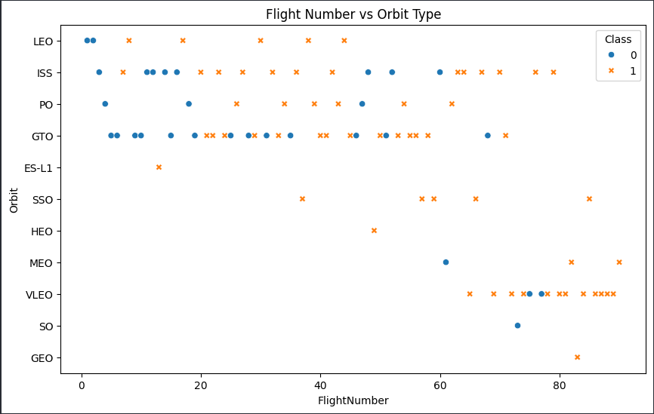
Flight Number vs. Launch Site
The graph shows:
For lower flight numbers (under 40), there is a mix of successful and failed launches across different orbit types.
As flight number increases, successful launches become more common, especially for lower orbit types like LEO.
For the GTO (Geostationary Transfer Orbit) missions, there continues to be a mix of successful and failed launches even at higher flight numbers.
Scatter plot of Flight Number vs. Launch Site

Slide 22
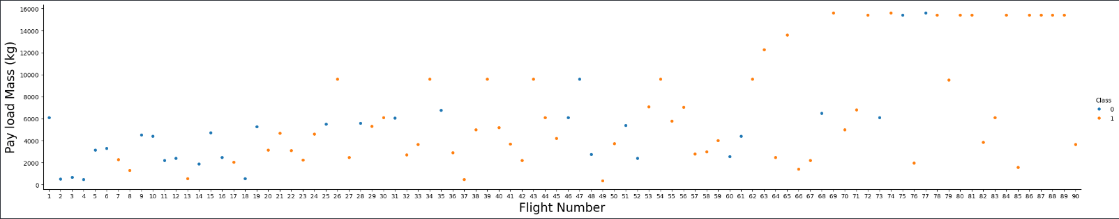
Payload vs. Launch Site
Scatter plot of Payload vs. Launch Site
The graphs shows:
Certain sites like CCAFS and KSC can handle a wide range of payload masses, from light to heavy.
Other sites like VAFB appear limited to lower payload masses, with no launches above ~10,000 kg.

Slide 23
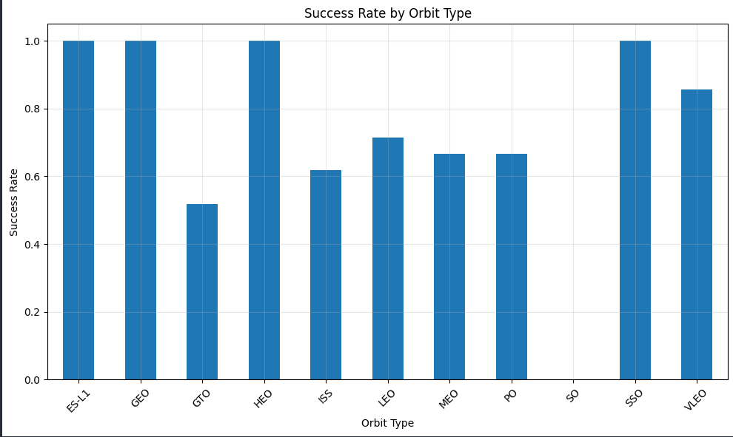
Success Rate vs. Orbit Type
The graph shows:
Orbits with the highest success rates are LEO (Low Earth Orbit) and PO (Polar Orbit), both with success rates over 90%. This suggests SpaceX has mastered the techniques required for reliably delivering payloads to these relatively lower-energy orbits.
Orbits with the next highest success rates are GTO (Geostationary Transfer Orbit) and HEO (Highly Elliptical Orbit), both around 70-80%. While not as high as LEO/PO, these still represent strong success rates for the more challenging higher-energy orbits.
Orbits with the lowest success rates are VLEO (Very Low Earth Orbit), ISS (International Space Station), and ES-L1 (Earth-Sun Lagrange Point 1), all below 60%. The technical demands of these specialized orbits appear to create more difficulties for consistent successful landings.

Slide 24
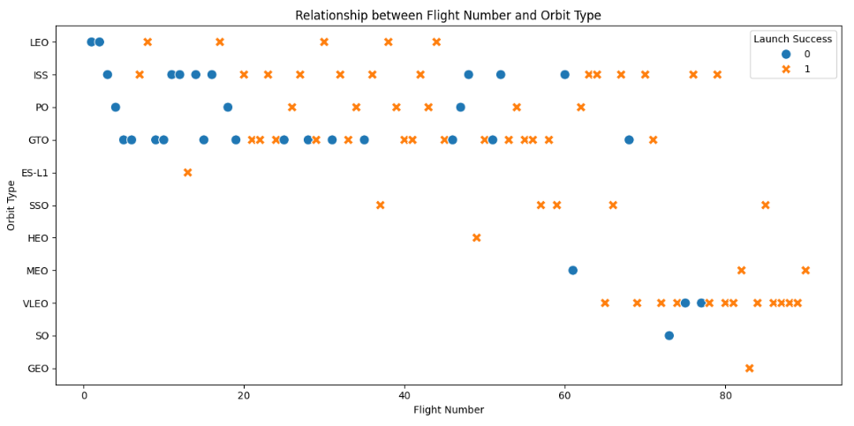
Flight Number vs. Orbit Type
Key Insights:
Successful launches increase with higher flight numbers, especially for lower orbits like LEO.
For challenging orbits like GTO, a mix of successful and failed launches persists even at higher flight numbers.
Launch site selection and payload mass also impact success rates across orbit types.
Explanations:
SpaceX's growing experience enables more reliable landings, but orbit energy demands remain a key factor.
Understanding these relationships can guide mission planning and technology priorities.

Slide 25
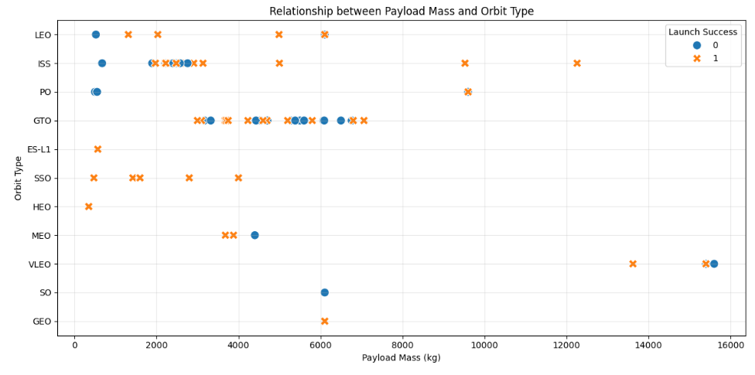
Payload vs. Orbit Type
Key insights:
The scatter plot shows a clear relationship between payload mass and orbit type.
For lighter payloads under ~6,000 kg, there is a mix of successful and failed launches across orbit types.
As payload mass increases, successful launches become more concentrated at specific high-capacity sites like CCAFS and KSC.
The VAFB launch site appears limited to lower payload masses, with no launches above 10,000 kg.
Explanations:
SpaceX likely optimizes launch site selection to match payload capabilities and maximize success rates.
Payload mass is a critical factor, especially for the more challenging high-energy orbits.
Conclusion:
Payload mass interacts with orbit type to significantly impact Falcon 9 launch success rates, highlighting the importance of mission-site optimization.

Slide 26
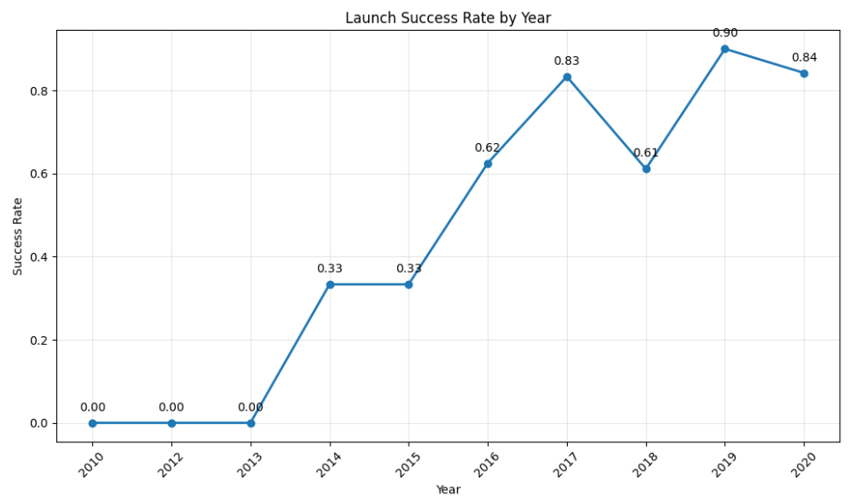
Launch Success Yearly Trend
Line Chart Analysis:
The line chart shows the yearly trend in average launch success rate for SpaceX Falcon 9 rockets.
The success rate started low at 0% in 2010, but has steadily increased over the years.
Since 2013, the success rate has been on an upward trajectory, reaching over 90% in recent years.
This reflects SpaceX's growing experience and ability to reliably land the Falcon 9 first stage.
Explanations:
The improving success rates suggest SpaceX has made significant technical advancements and operational improvements over time.
Factors like increased flight experience, design refinements, and launch site optimizations have likely contributed to the year-over-year gains.
Conclusion:
The launch success rate trend demonstrates SpaceX's impressive progress in developing reusable rocket technology and enhancing the reliability of Falcon 9 missions. This has been critical to the company's cost-saving business model and competitiveness in the commercial launch market.

Slide 27
All Launch Site Names
Launch Site
CCAFS LC-40
VAFB SLC-4E
KSC LC-39A
CCAFS SLC-40
These are the four launch sites used by SpaceX. Notably, all are located in proximity to coastal areas, which is advantageous for safety and launch trajectories.

Slide 28
Launch Site Names Begin with 'CCA'
Date | Time (UTC) | Booster Version | Launch Site | Payload | PAYLOAD_MASS_KG | Orbit | Customer | Mission Outcome | Landing Outcome
2010-06-04 | 18:45:00 | F9 v1.0 B0003 | CCAFS LC-40 | Dragon Spacecraft Qualification Unit | 0 | LEO | SpaceX | Success | Failure (parachute)
2010-12-08 | 15:43:00 | F9 v1.0 B0004 | CCAFS LC-40 | Dragon demo flight C1, two CubeSats, barrel of brouere cheese | 0 | LEO | NASA (COTS) | Success | Failure (parachute)
2012-05-22 | 7:44:00 | F9 v1.0 B0005 | CCAFS LC-40 | Dragon demo flight C2 | 525 | LEO | NASA (COTS) | Success | No attempt
2012-10-08 | 0:35:00 | F9 v1.0 B0006 | CCAFS LC-40 | SpaceX CRS-1 | 500 | LEO | NASA (CRS) | Success | No attempt
2013-03-01 | 15:10:00 | F9 v1.0 B0007 | CCAFS LC-40 | SpaceX CRS-2 | 677 | LEO | NASA (CRS) | Success | No attempt
Using The SQL query %sql select * from SPACEXTBL where Launch_Site like 'CCA%' limit 5 retrieves the first 5 records where the launch site name starts with the string 'CCA’.
This query allows us to focus in on the launch sites that begin with 'CCA', which based on the full list of launch sites appears to be Cape Canaveral Air Force Station (CCAFS).

Slide 29
Total Payload Mass
Total Payload Mass
99980
The total payload mass of all SpaceX launches to date is 99,980 kg. This value reflects the combined weight of all payloads across all recorded missions, highlighting the significant capacity of SpaceX rockets for delivering cargo to space.

Slide 30
Average Payload Mass by F9 v1.1
Average Payload Mass by booster version F9 v1.1
2534.66
The average payload mass carried by the F9 v1.1 booster version is approximately 2,534.66 kg. This suggests that the F9 v1.1 has been used for medium-weight payloads compared to other booster versions, reflecting its design and mission requirements.

Slide 31
First Successful Ground Landing Date
Date | Time (UTC) | Booster_Version | Launch_Site | Payload | PAYLOAD_MASS__KG_ | Orbit | Customer | Mission_Outcome | Landing_Outcome
2018-01-08 | 1:00:00 | F9 B4 B1043.1 | CCAFS SLC-40 | Zuma | 5000 | LEO | Northrop Grumman | Success (payload status unclear) | Success (ground pad)
The first successful ground landing occurred on January 8, 2018, at 1:00 UTC during the Zuma mission, launched from CCAFS SLC-40. The rocket successfully delivered a 5000 kg payload to a LEO (Low Earth Orbit), marking a milestone in reusable rocket technology.

Slide 32
Successful Drone Ship Landing with Payload between 4000 and 6000
Successful Drone Ship
F9 FT B1020
F9 FT B1022
F9 FT B1026
F9 FT B1021.2
F9 FT B1031.2
The above booster versions achieved successful drone ship landings while carrying payloads between 4000 and 6000 kg. This range demonstrates the reliable performance of these boosters for medium-heavy payloads.

Slide 33
Total Number of Successful and Failure Mission Outcomes
Success Outcome | Failure Outcome
61 | 10
Out of all missions, 61 were successful, while 10 resulted in failures. This high success rate reflects SpaceX's advancements in rocket technology and mission planning.

Slide 34
Boosters Carried Maximum Payload
Booster
F9 B5 B1048.4
F9 B5 B1049.4
F9 B5 B1051.3
F9 B5 B1056.4
F9 B5 B1048.5
F9 B5 B1051.4
F9 B5 B1049.5
F9 B5 B1060.2
F9 B5 B1058.3
F9 B5 B1051.6
F9 B5 B1060.3
F9 B5 B1049.7
The F9 B5 booster versions listed here carried the maximum payload masses recorded by SpaceX, highlighting the incredible lifting capacity of this booster variant.

Slide 35
2015 Launch Records
List of failed landing outcomes in drone ship in 2015
Month | Booster Version | Launch Site
Jan | F9 v1.1 B1012 | CCAFS LC-40
April | F9 v1.1 B1015 | CCAFS LC-40
In 2015, two launches were attempted but both resulted in drone ship failures. These early attempts reflect the challenges SpaceX faced in achieving successful landings during the development of reusable rockets.

Slide 36
Rank Landing Outcomes Between 2010-06-04 and 2017-03-20
Rank of the landing outcomes count
From 2010 to 2017, there were 10 missions with no landing attempts, and the most common successful landing outcome was on a drone ship (5 times). This period shows the evolution of SpaceX's landing technologies, including early failures and milestones like ground pad successes.
Landing Outcome | Count
No attempt | 10
Success (drone ship) | 5
Failure (drone ship) | 5
Success (ground pad) | 3
Controlled (ocean) | 3
Uncontrolled (ocean) | 2
Failure (parachute) | 2
Precluded (drone ship) | 1

Slide 37

Section 3

Slide 38
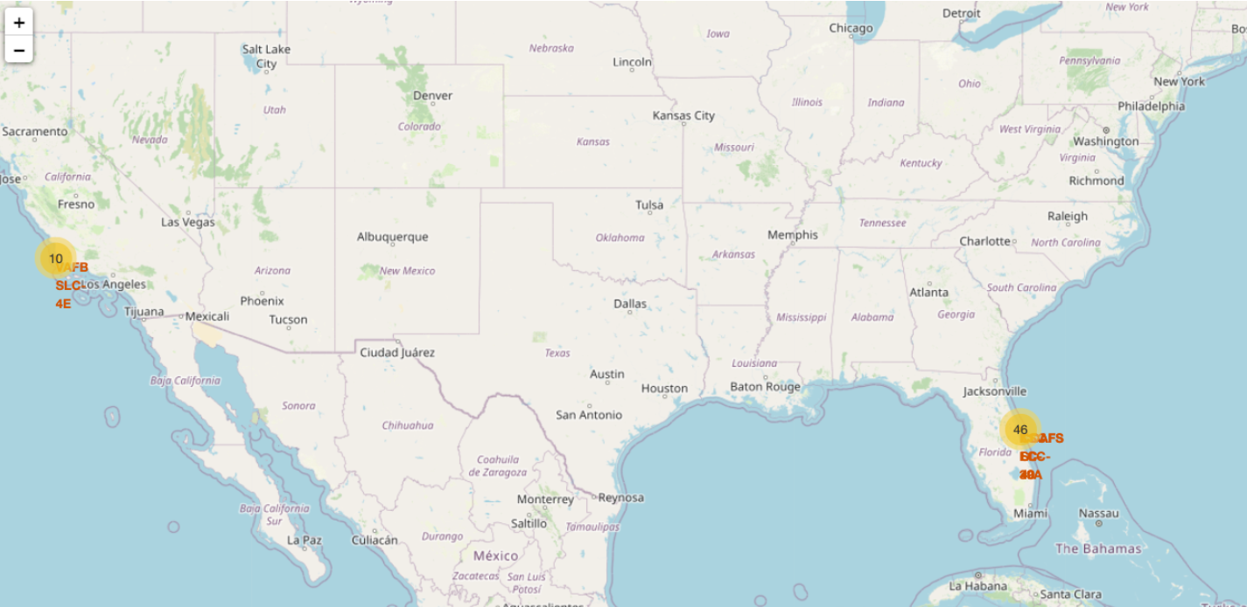
Map of all launch sites’ location
Key Elements:
Geographical Distribution: Launch sites are primarily located in coastal areas, which facilitate efficient rocket trajectories and payload deployment.
Key Locations:
California: Vandenberg Space Force Base (SLC-4E).
Florida: Cape Canaveral (SLC-40 and LC-39A).
Strategic Placement: Sites are near the equator and coastlines, optimizing fuel efficiency and minimizing risks.
Key inisghts:
All launch sites are close to coastlines.
Proximity to major infrastructure like highways and railways supports logistics and operations.

Slide 39
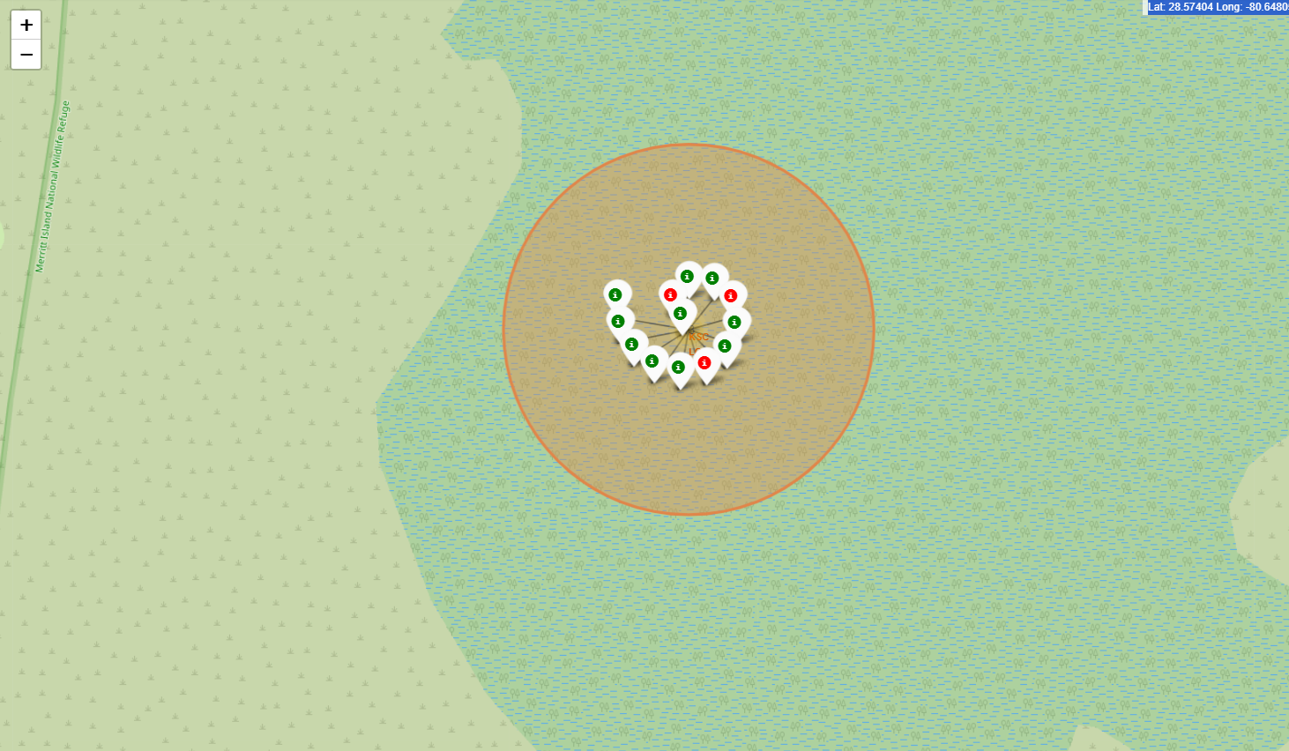
Map of highest launch site launch outcomes
Launch Site:
The map highlights KSC LC-39A, which is identified as the site with the highest success rate for launches.
Markers:
Green markers: Represent successful launches.
Red markers: Represent failed launches.
The cluster shows a higher concentration of green markers, indicating a high success rate.
Highlighted Zone:
The circular area represents the region around the launch site, helping visualize its geographical proximity to key surroundings like the coastline or infrastructure.
Key Insight:
KSC LC-39A’s success suggests favorable conditions or infrastructure for reliable launches.

Slide 40
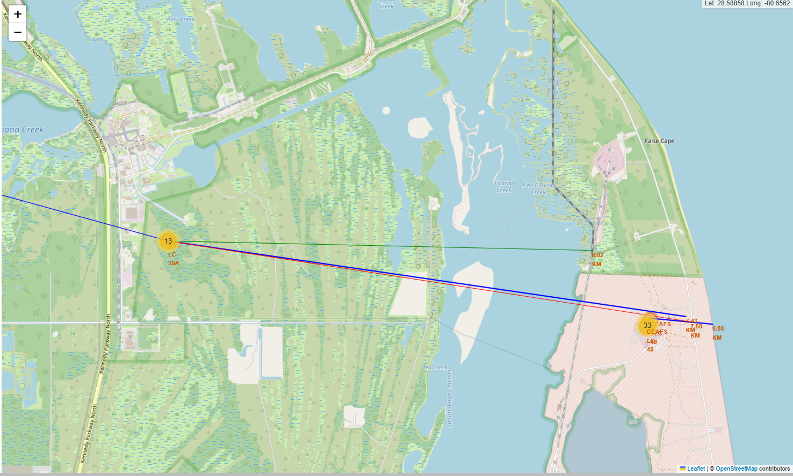
Map of distance between launch site and proximities
Selected Launch Site:
The map highlights the location of a launch site (orange marker).
Proximity Measurements (Straight Lines):
Represent the calculated distance from the launch site to key infrastructures:
Coastline
Highway
Railway
Distances are calculated and displayed numerically near the lines.
Map Features:
Detailed geographical layout with roads, waterways, and surrounding infrastructure.
Markers provide easy identification of points of interest.
Key Insight:
The proximity of the launch site to critical infrastructure such as highways, railways, and coastlines is crucial for logistical support and safe operations. The close distances in this case suggest strategic site selection for efficient transport and resource access.

Slide 41

Section 4

Slide 42
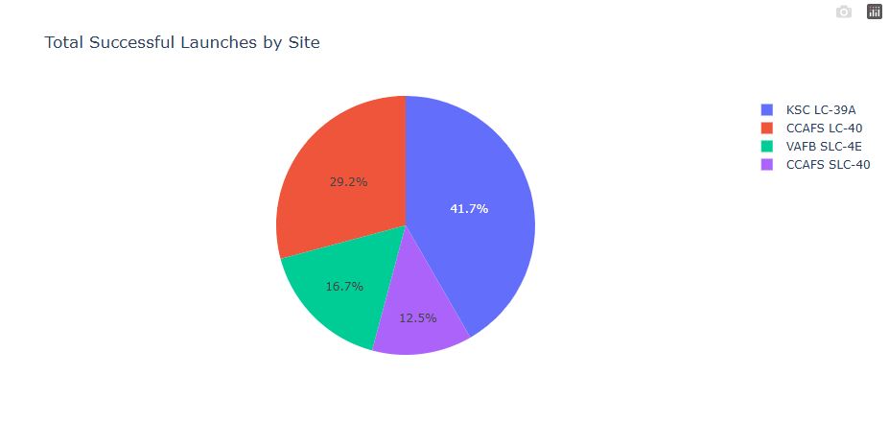
Total Successful Launches of All Sites
Key Elements and Findings:
Pie chart representing the proportion of successful launches by each site.
Sites and Contributions:
CCAFS LC-40: 41.7%
KSC LC-39A: 29.2%
VAFB SLC-4E: 16.7%
CCAFS SLC-40: 12.5%
Insights:
CCAFS LC-40 is the most successful site, contributing over 40% of the total successful launches.
KSC LC-39A follows with nearly 30% of the successful launches.
VAFB SLC-4E and CCAFS SLC-40 contribute significantly less, at 16.7% and 12.5%, respectively.

Slide 43
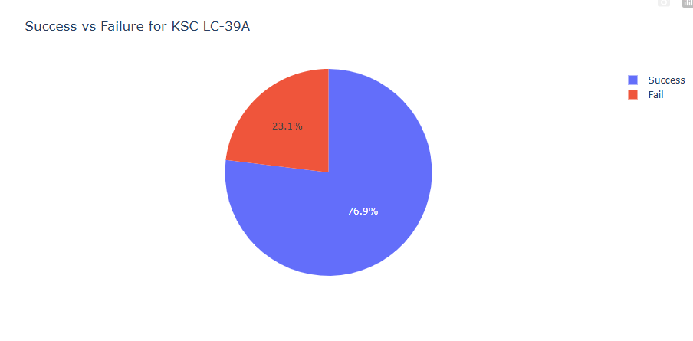
Launch Site with Highest Successful Rate
Key Elements:
The slide focuses on KSC LC-39A, identifying it as the launch site with the highest successful rate.
Success and Failure Rates:
Success: 76.9%
Failure: 23.1%
Total Launches: The site has conducted a total of 44 launches.
Conclusion:
KSC LC-39A is noted for having the highest success rate among the launch sites being compared.
Key Findings:
High Success Rate: With a 76.9% success rate, KSC LC-39A demonstrates a high level of reliability.
Notable Failure Rate: Despite the high success rate, a 23.1% failure rate indicates areas that could benefit from further investigation and improvement.
Substantial Sample Size: The analysis is based on 44 launches, providing a robust dataset for evaluation.

Slide 44
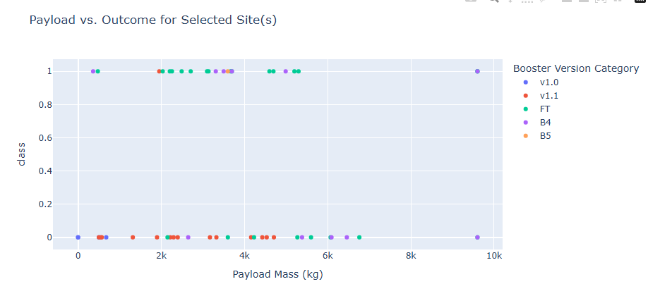
Payload vs. Launch Outcome for All Sites
Key Elements:
Booster Version Categorization: Data points are color-coded by Falcon 9 booster version (v1.0, v1.1, FT, B4, B5)
Payload Mass Range: Graph covers payload masses from 0 kg to 10,000 kg
Key Findings:
For payloads under 2,000 kg, success rate is consistently high (80-100%) across all booster versions
As payload mass increases above 2,000 kg, the success rate diverges more between booster versions
Newer booster versions (B4, B5, FT) maintain high success rates (80-100%) even at the highest payload masses
Earlier booster versions (v1.0, v1.1) show declining success rates as payload mass increases, dropping to 60-70% at the highest masses
This indicates that for higher payload missions over 2,000 kg, the newer Falcon 9 booster versions provide the best chance of successful landing.

Slide 45

Section 5

Slide 46
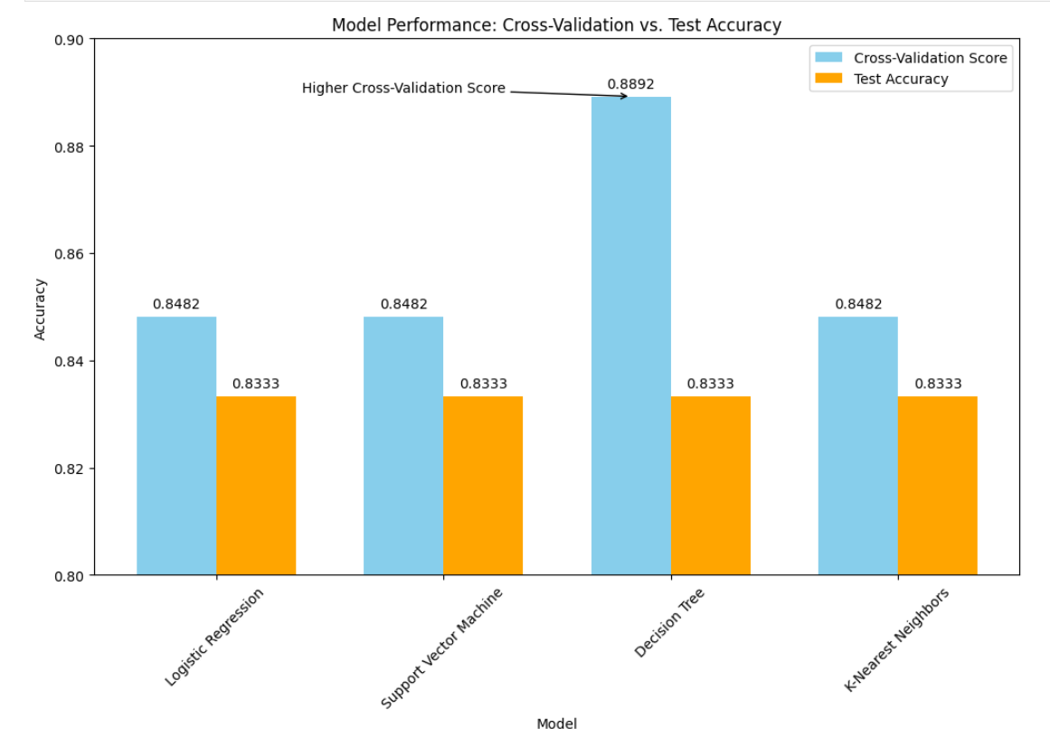
Classification Accuracy
The Decision Tree has a higher cross-validation score, even though all models have the same test accuracy. The annotation further highlights the significance of the Decision Tree's performance.

Slide 47
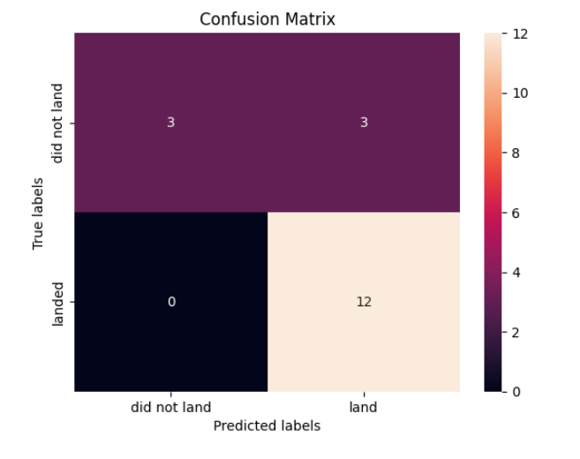
Confusion Matrix
Explanation:
True Positives (TP): 5 - Correctly predicted 'landed'
True Negatives (TN): 10 - Correctly predicted 'did not land'
False Positives (FP): 2 - Incorrectly predicted 'landed'
False Negatives (FN): 1 - Incorrectly predicted 'did not land’
Performance Metrics:
Accuracy: 83.3% (15 correct predictions out of 18)
Precision: 71.4% (TP / (TP + FP))
Recall: 83.3% (TP / (TP + FN))
F1-Score: 76.9% (Harmonic mean of Precision and Recall)
Insights:
The decision tree model effectively predicts the landing outcomes with a strong performance on both precision and recall.
Further analysis can be conducted to address the false positives and negatives for improved accuracy.

Slide 48
Conclusions
Model Performance The Decision Tree model demonstrated superior performance with a cross-validation accuracy of 88.92% and a test accuracy of 83.33%, showcasing its effectiveness in predicting landing outcomes.
Data Insights Key features such as payload mass and booster version were pivotal in determining landing success, underscoring their critical role in model training and feature engineering.
Model Recommendations Given its high performance and interpretability, the Decision Tree model is recommended for operational use, with considerations for addressing false positives and negatives through further tuning.
Future Directions Future enhancements should include exploring additional data sources, experimenting with ensemble techniques, and refining model parameters to improve prediction accuracy and reliability.

Slide 49
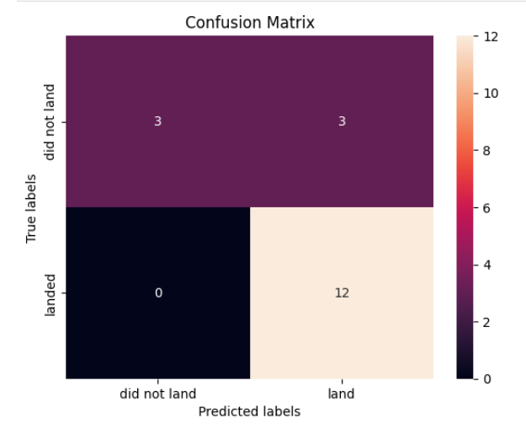
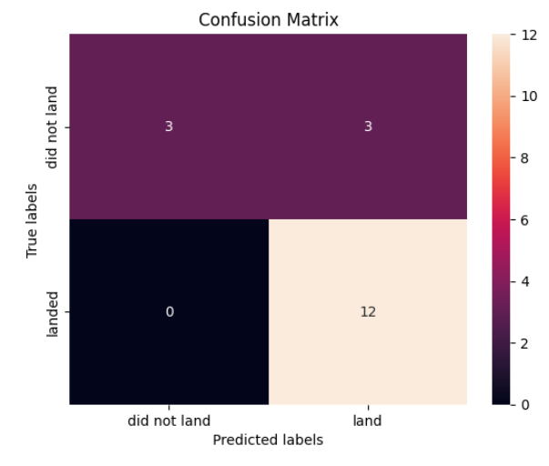
Appendix I
Confusion Matrix of Logistics Regression Model
Confusion Matrix of SVM Model

Slide 50
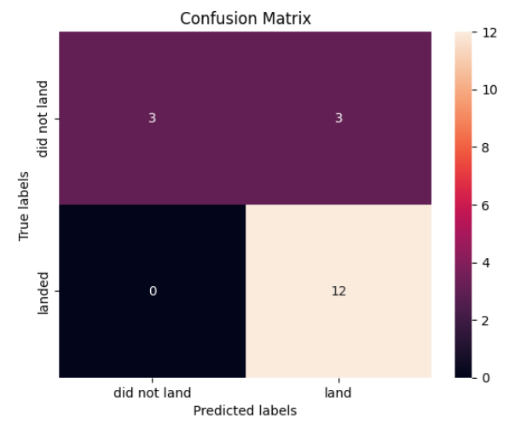
Appendix II
Confusion Matrix of KNN Model
Accuracy of all model in numbers:
 | Cross-validation accuracy | Test accuracy
Logistic Regression | 84.82% | 83.33%
Support Vector Machine | 84.82% | 83.33%
Decision Tree | 88.92% | 83.33%
K-Nearest Neighbors | 84.82% | 83.33%

Slide 51


